Slide 1

Docker Fundamentals
TGIF Series
Sujil Maharjan

Slide 2
What is Docker?
Platform as a Service that uses containerizes your applications for deployment
Flexible, modular, easy to migrate, secure, easy to scale

Slide 3
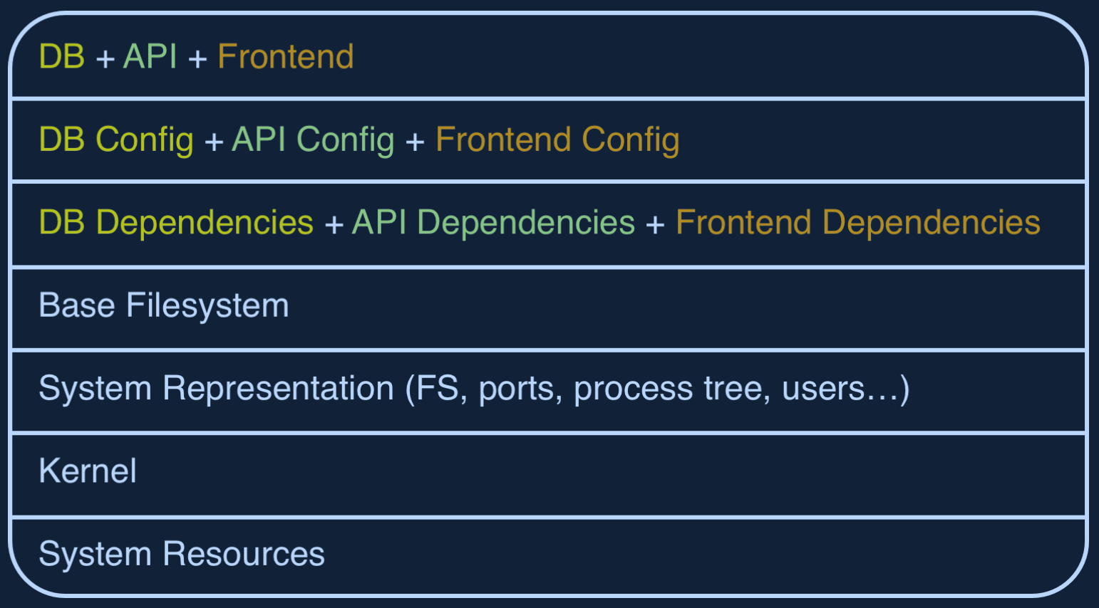
Without Containerization

Slide 4
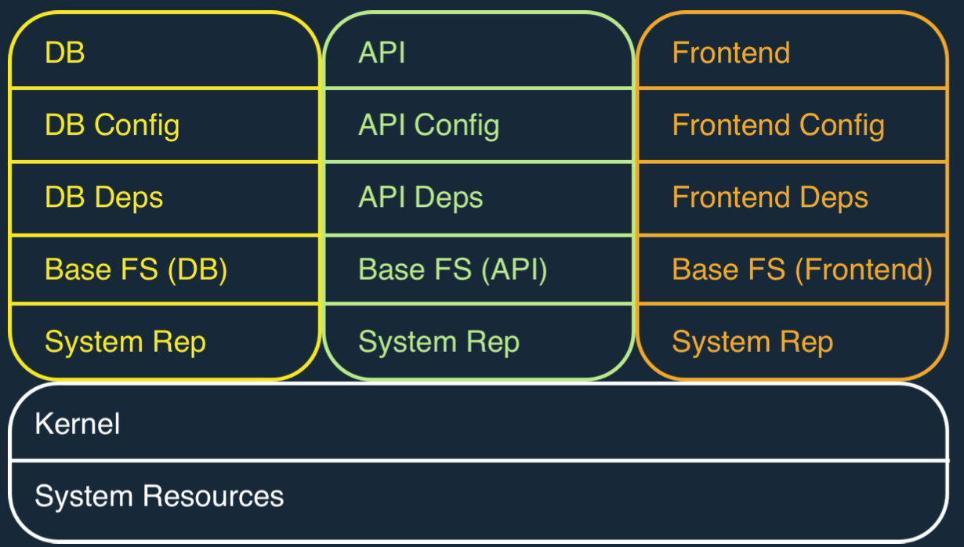
With Containerization

Slide 5
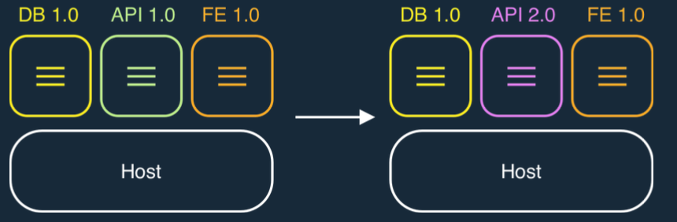
Rapid Development
Containers can be replaced easily with minimal impact on other components

Slide 6
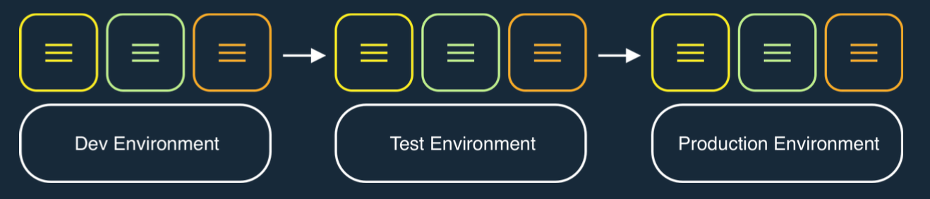
Smooth Migration
Migrating the application across various environments is very simple and keeps minimal impact on the hosts that run them

Slide 7
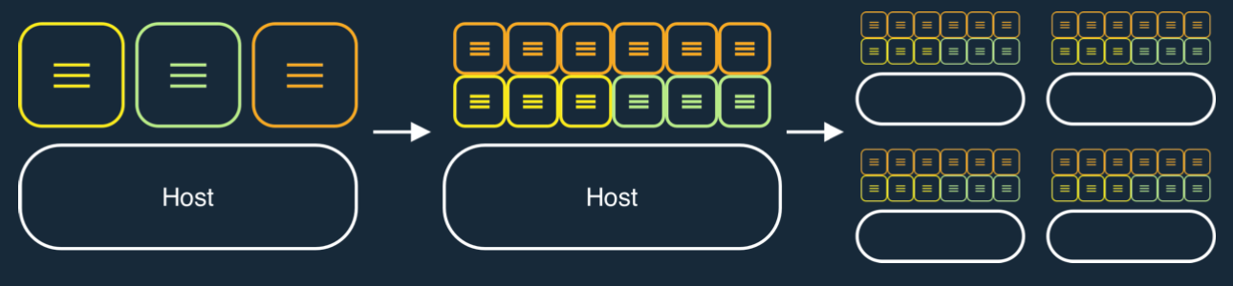
Simple Scale & Maintainance
There is weak coupling between containers. So, scaling is simplified

Slide 8
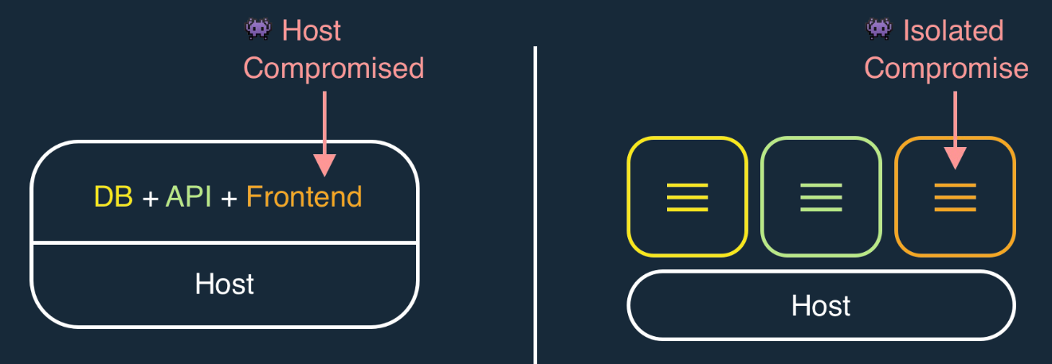
Secure by Default

Slide 9
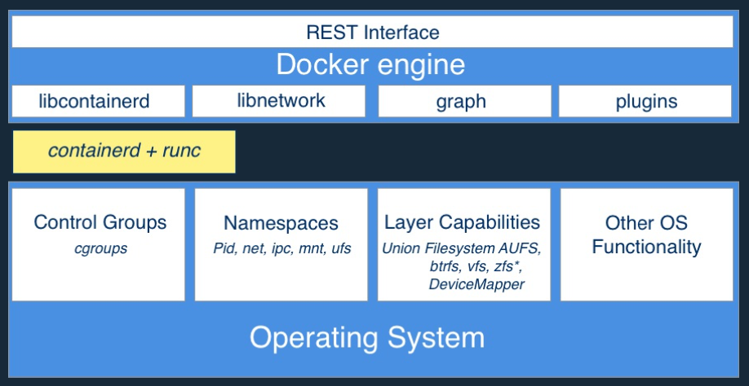
Architecture

Slide 10
Docker Containers
An isolated process that runs the docker image on top of host machine
It has its own kernel namespace, filesystem, networking and a process tree separate from host machine
- Can be thought of as a “virtual environment”

Slide 11
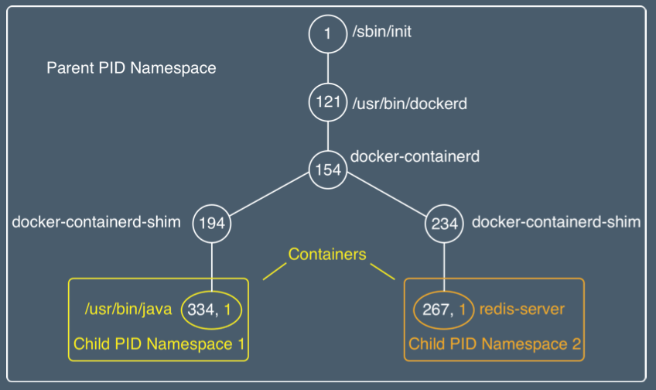
Linux PID Kernel Namespace

Slide 12
Optional Isolation Features
Control groups: limit memory & CPU
Root privilege management
System calls management
By default, root privilege and syscalls are restricted for docker containers

Slide 13
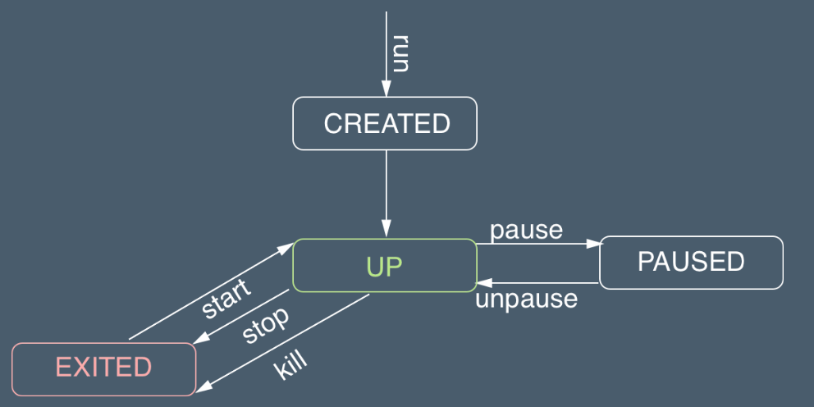
Container Lifecycle

Slide 14
Demo
Process Isolation
Docker containers

Slide 15
Docker Images
Filesystem for container process
Made up of stack of immutable layers
Starts with a base image and adds layers with each addition/action
3. Add files related to your application
2. Add IIS
1. Environment / nano servers

Slide 16
Sharing Layers and Writable layer
 | R/W container layer
R/W container layer | 4. Add .jar
3. Add build step | 3. Add dependencies
2. NPM install | 2. Add Java Runtime
1. Base Image Layer (windows/linux)
Host Kernel

Slide 17
Creating Images
Using Commit
docker container commit <container_id>
Define a Dockerfile (Recommended)
Import a tarball into Docker

Slide 18
Dockerfiles
Provides Image Layer documentation
Commands
FROM command defines a base image
Each additional command adds a layer
docker image build… builds the image

Slide 19
Image Creation Demo

Slide 20
More Dockerfile commands
CMD and ENTRYPOINT defines what to run in the default process PID 1
CMD alone: default command and list of parameters
CMD + ENTRYPOINT: Entrypoint provides command, CMD provides parameters
COPY: Copies the files from build context to image
RUN: Runs commands
ADD: Fetches tar files or urls

Slide 21
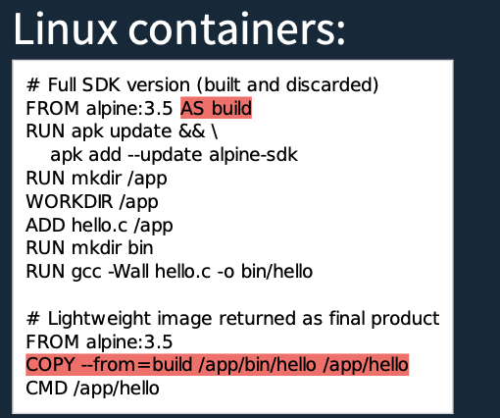
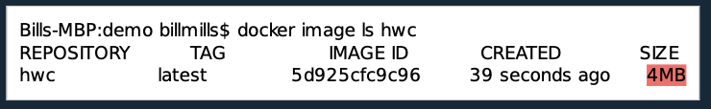
Multi-Stage Build
Notes:
https://github.com/garethr/multi-stage-build-example

Slide 22
Good Practices for Images
Use official images (dockerhub)
Use Multi-stage build to drop compilers/sdk…
More layers for better caching
Fewer layers for better performance

Slide 23
Sharing the images built
Share the images through registry like DockerHub, ECR (AWS)

Slide 24

Docker Volumes

Slide 25
Docker Volumes
Creates a mount point for storing container data
Data Persistance
Can be specified in Dockerfiles or separately through cli

Slide 26

Quick Demo

Slide 27
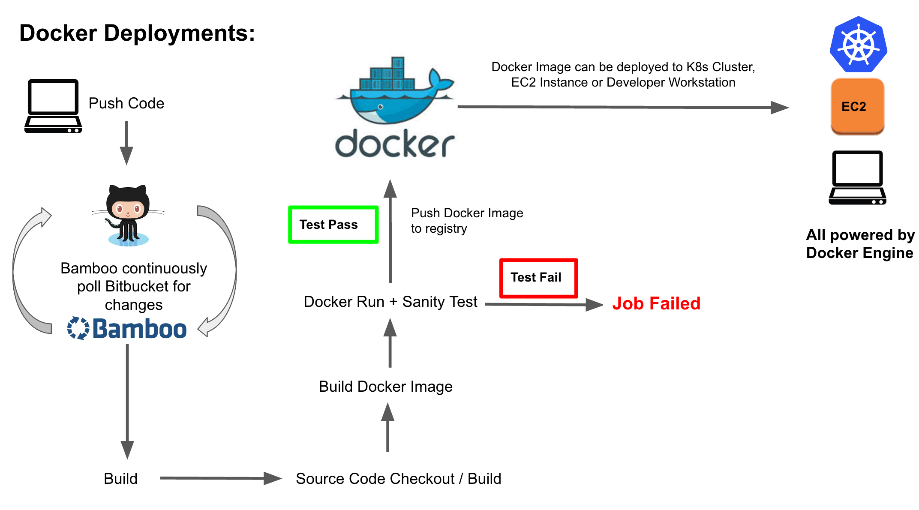

Slide 28
Docker Compose

Slide 29
Compose
Way to describe an entire application
docker-compose.yml
Facilitates multi-container design on a single node
Scales the application easily
Makes single node orchestration easy

Slide 30




Docker-Compose: Services
Click this link

Slide 31
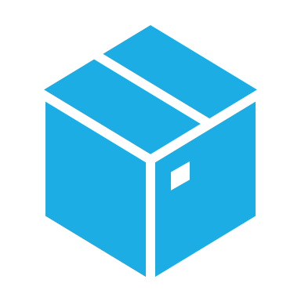
Container Orchestration Kubernetes

Slide 32
Why do we need orchestration?
Distribute the application containers across multiple nodes
High availability
High stability
High scalability

Slide 33
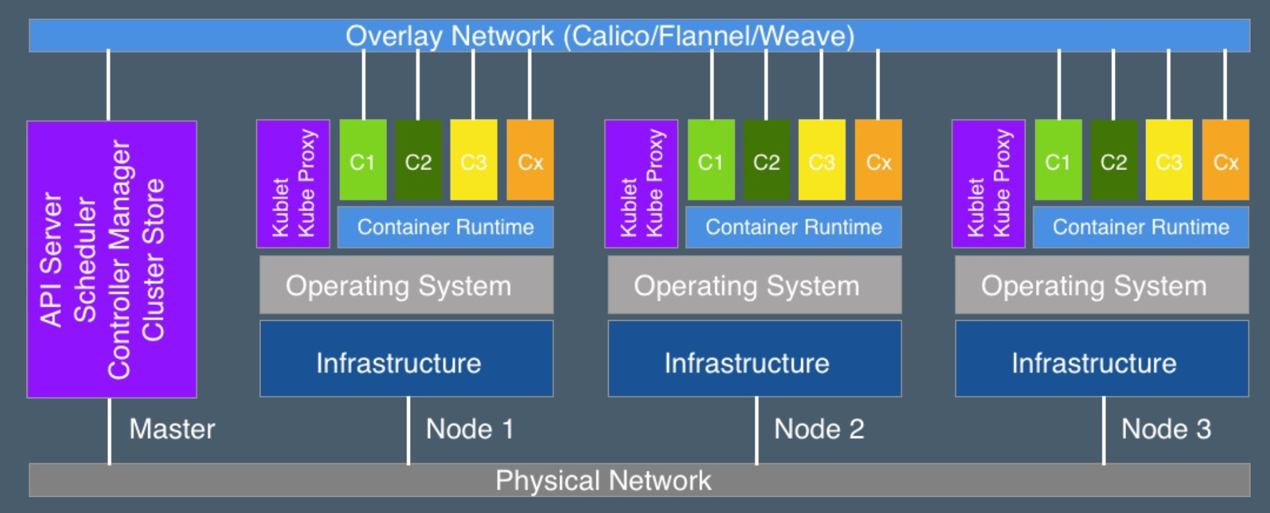
Kubernetes Cluster

Slide 34
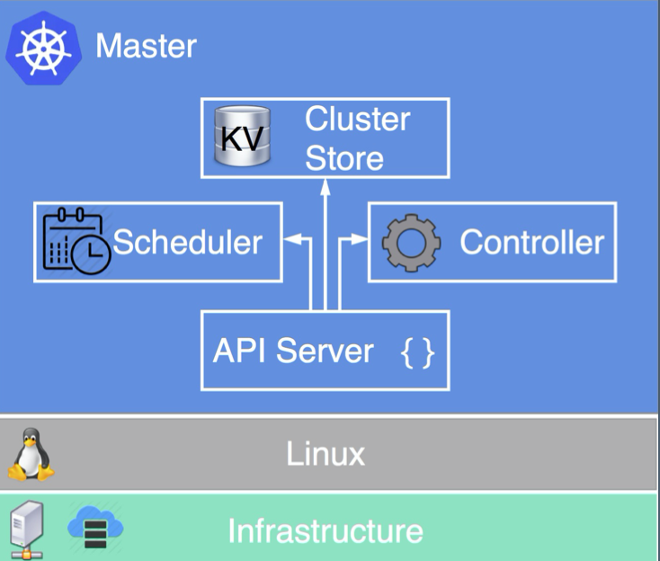
Kubernetes Master
API Server: Frontend to the Kubernetes control plane
Cluster Store: Config and state store
Controller Manager: Asserts desired State
Scheduler: Handles workload to different nodes

Slide 35
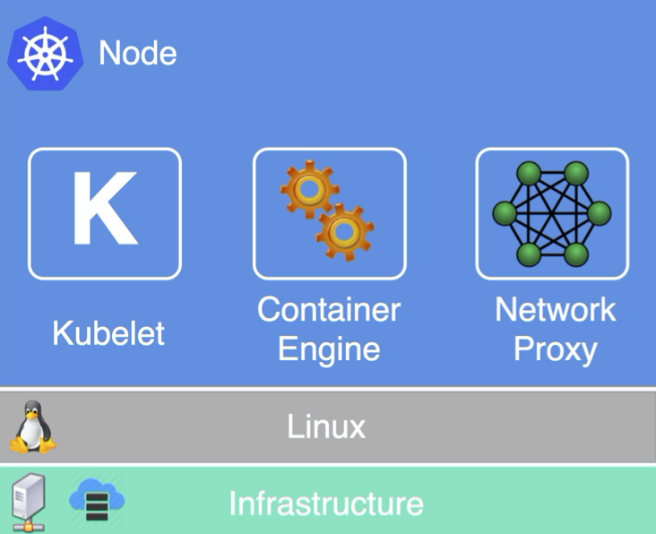
Kubernetes Node
Kubelet: Kubernetes agent
Container Engine: Host Containers
Network Proxy: Networking and Load balancing

Slide 36
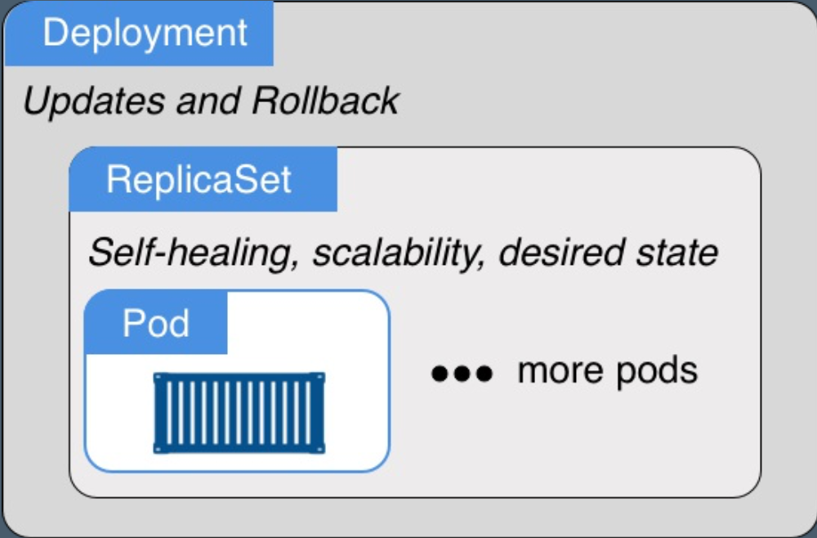
Kubernetes Orchestration Objects

Slide 37
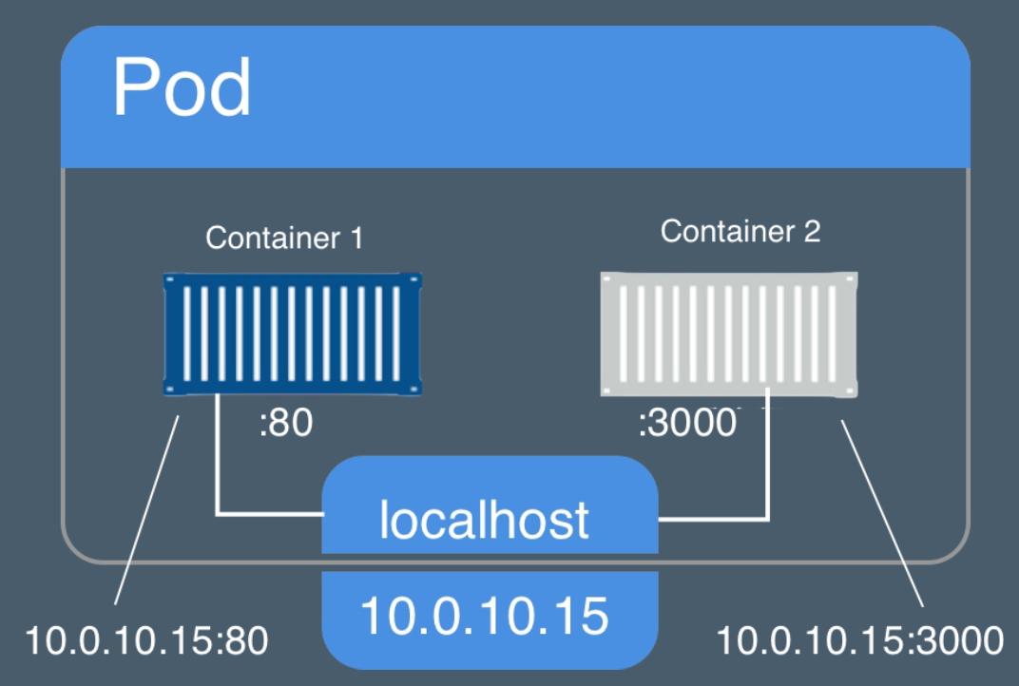
Pods

Slide 38
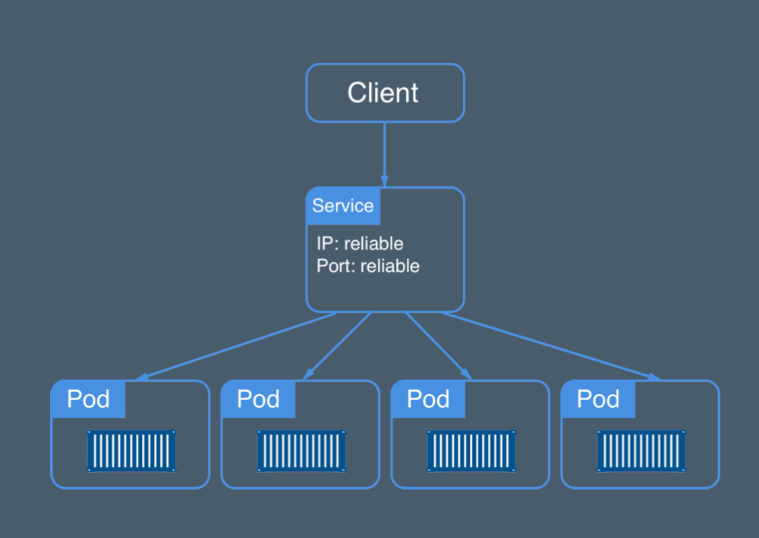
Services

Slide 39
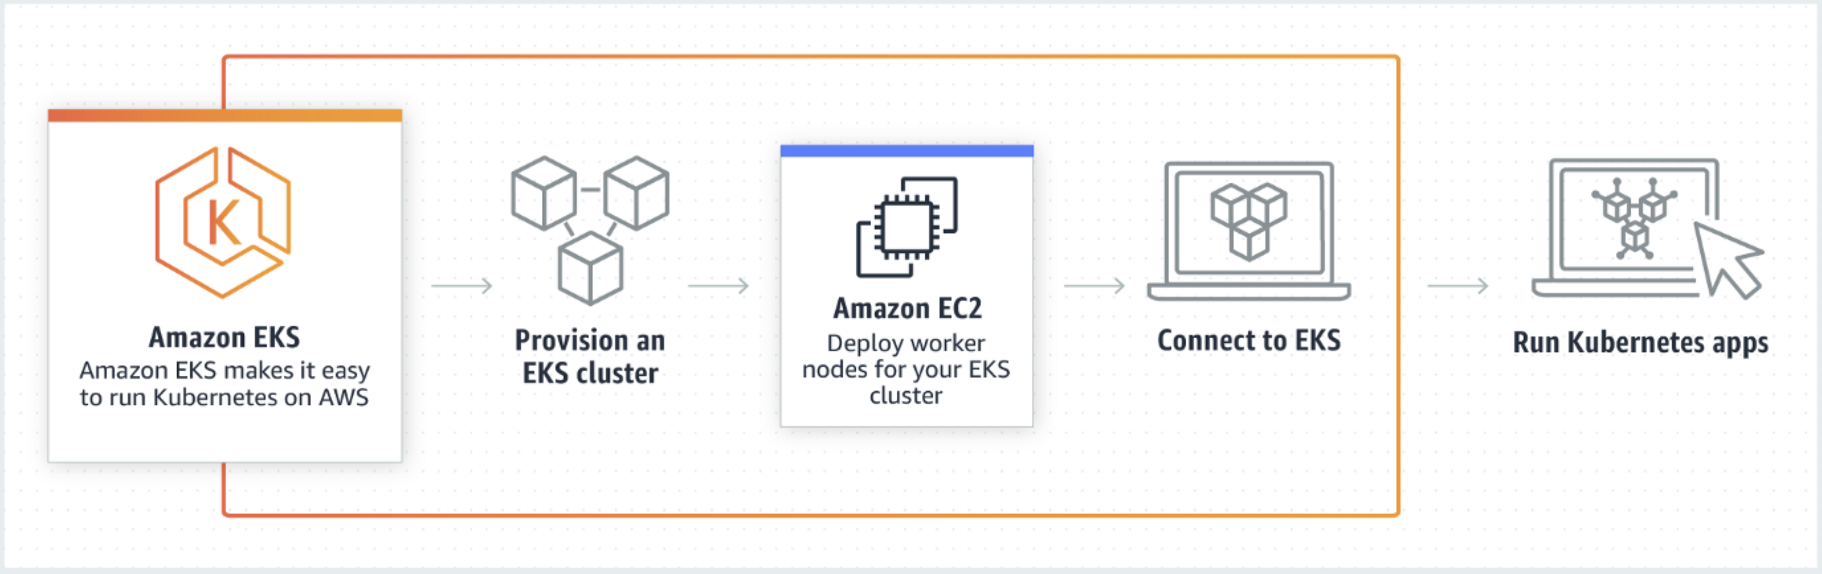
EKS in AWS

